Slide 1


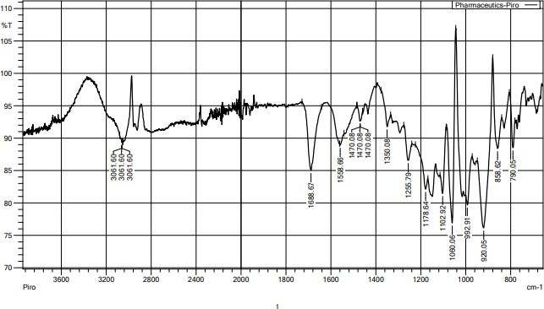
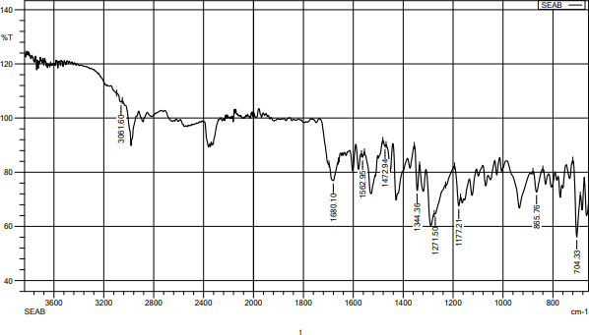
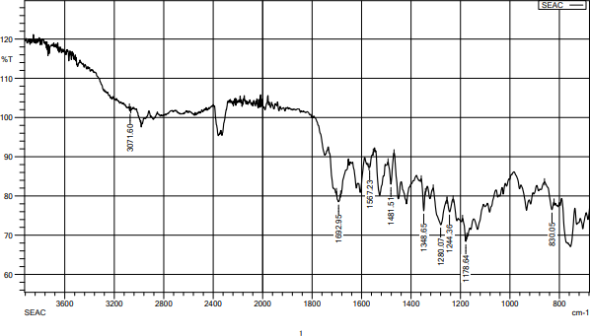
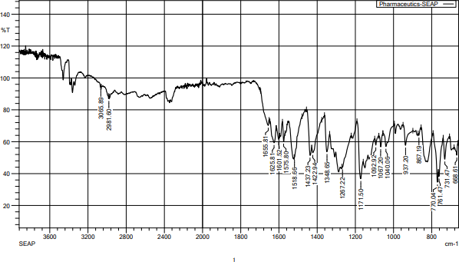
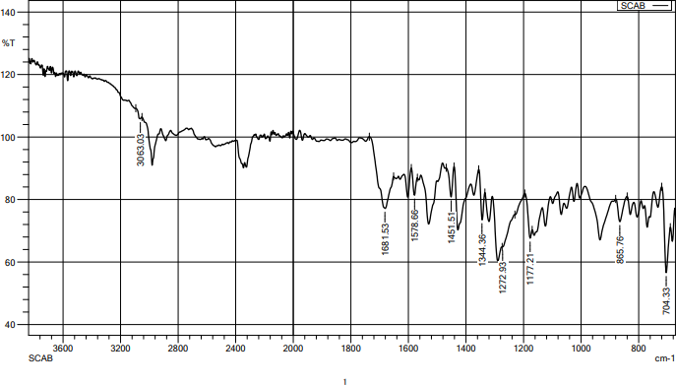
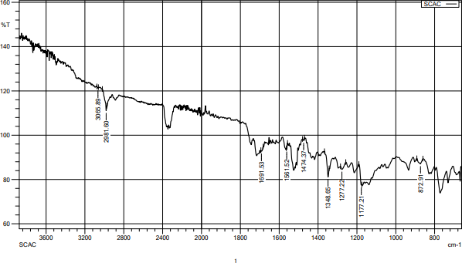
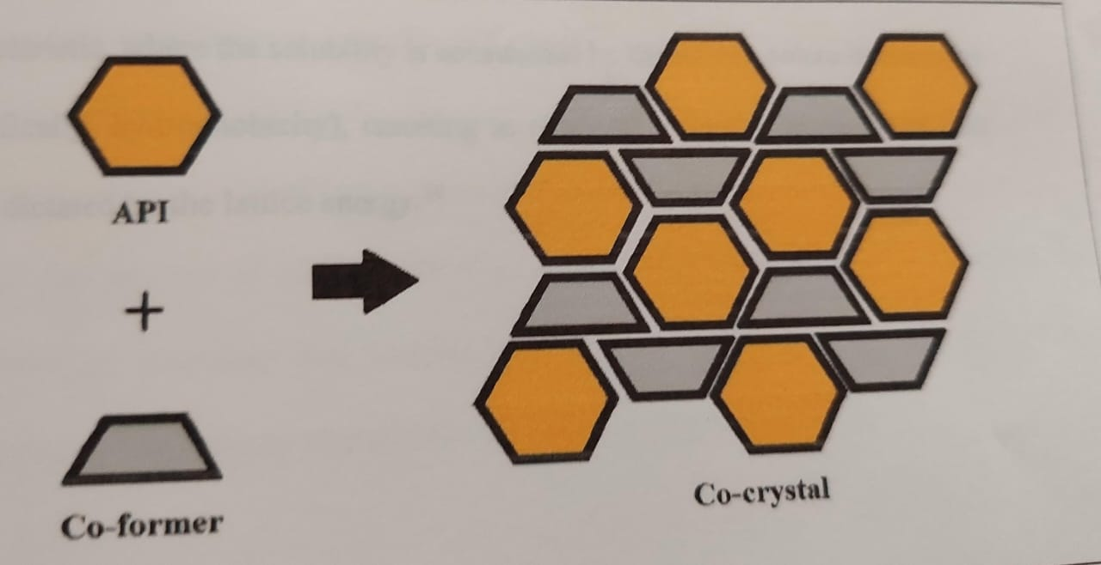
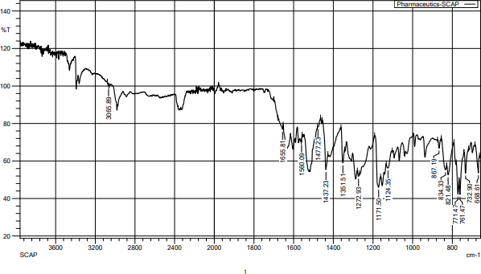
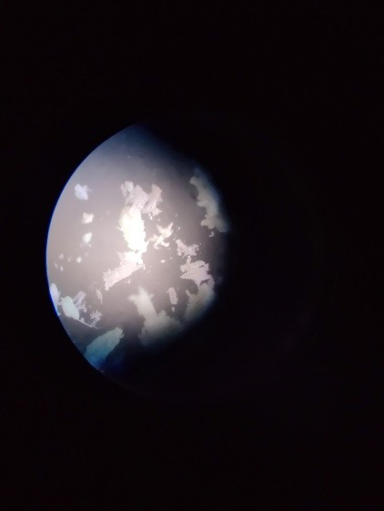
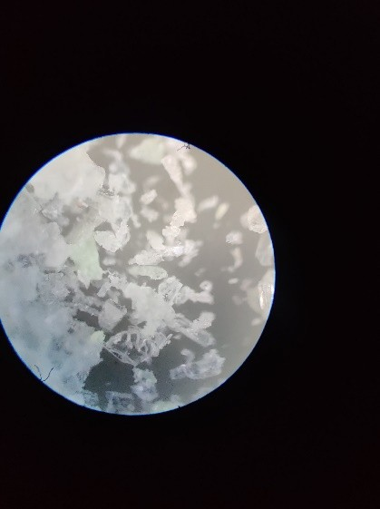
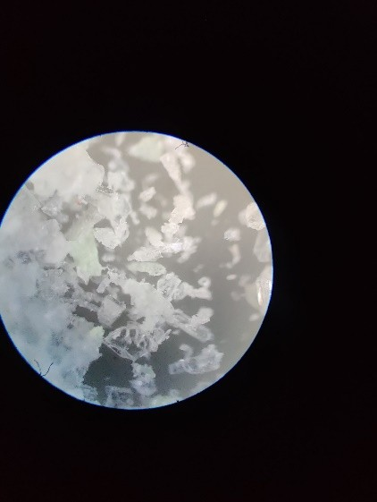
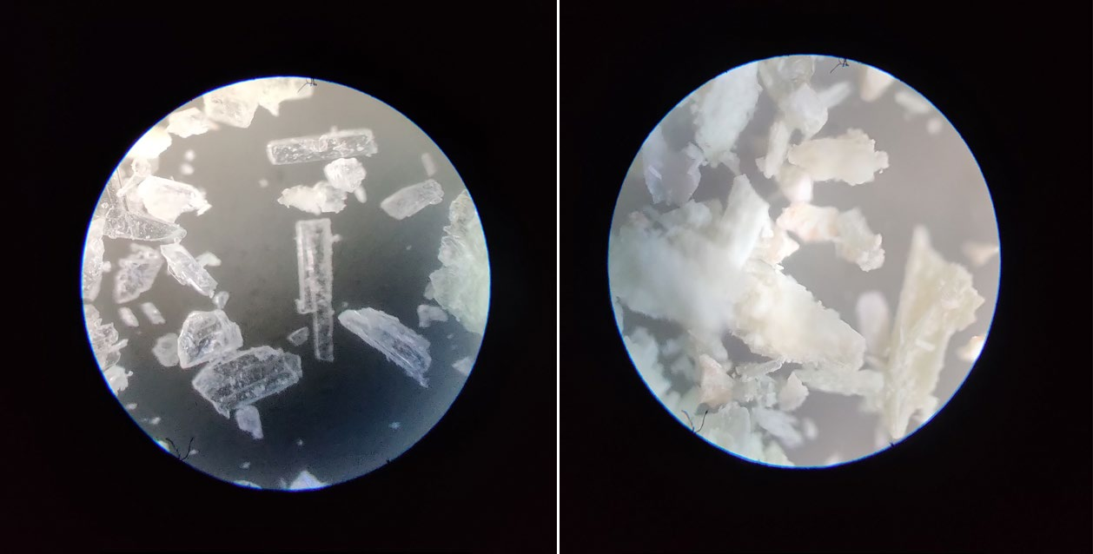
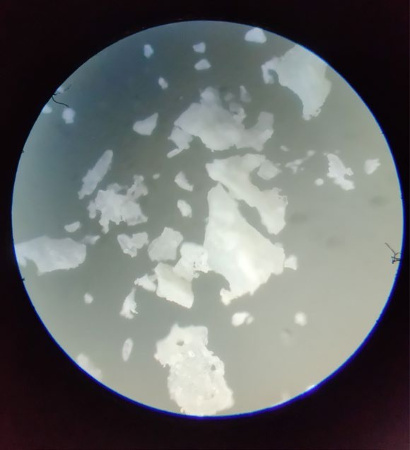
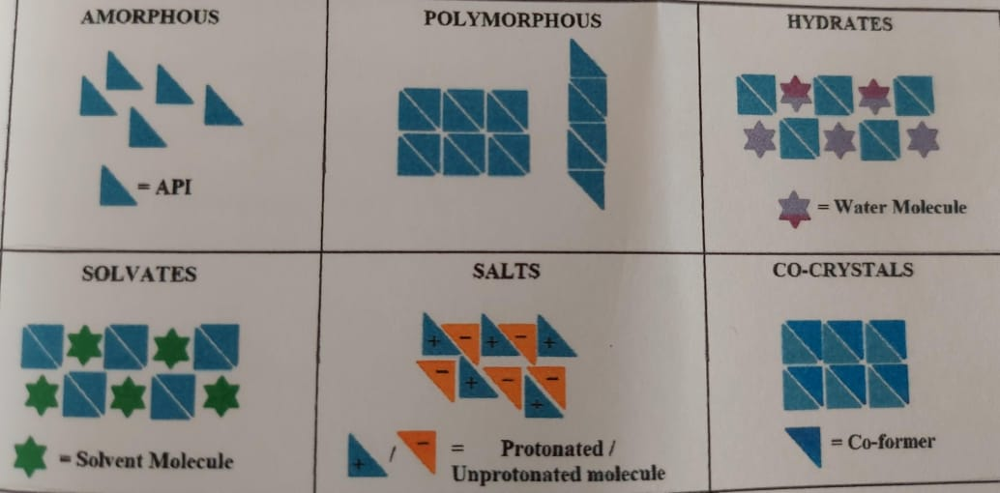
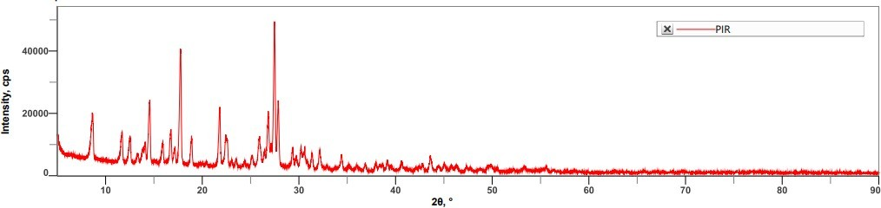
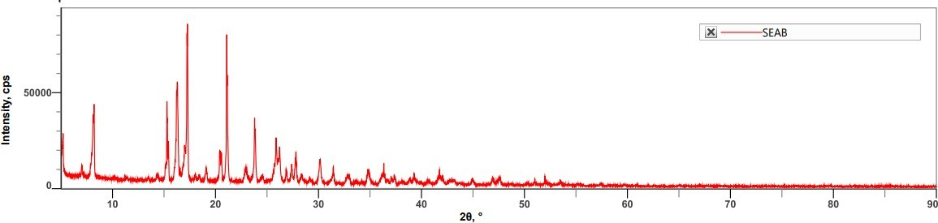
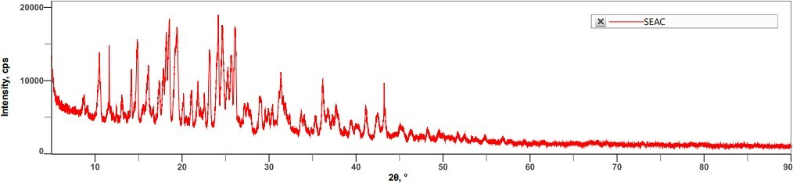
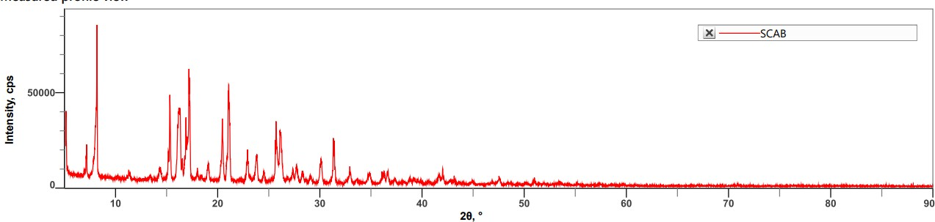
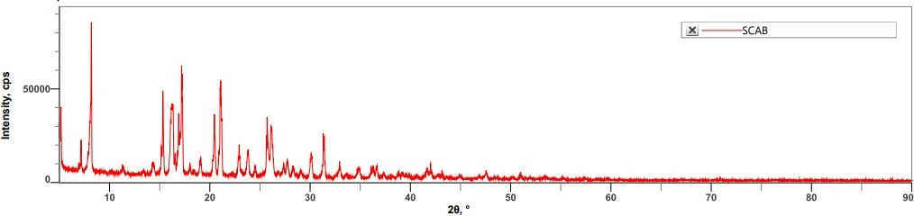
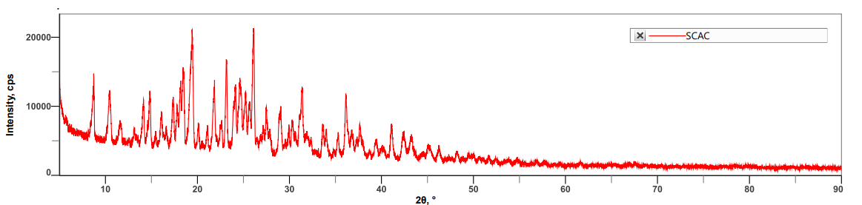
COMPARATIVE EVALUATION OF CO-CRYSTALLIZATION METHODS FOR SOLUBILITY ENHANCEMENTOF POORLY WATER SOLUBLE DRUG OF BCS CLASS II
Mahima A Mudhole, D’Souza Leejoan Mataias, Harish K H.
Department of pharmaceutics, KLE’S college of pharmacy, Hubballi, Karnataka-580031
mahimamudhole29@gmail.com
Abstract Code: PT_PP_159
Co-crystallization is a process of formation of co-crystals by the mixture of API and crystal conformer to form a co-crystal formation.
Drugs with low water solubility are predisposed to poor and variable oral bioavailability and therefore to variability in clinical response that might be overcome through an appropriate formulation of the drug.
The polymorphic solids exhibit different physiological properties. Polymorphism has acheived significance during recent years due to the fact that different polymorphs of a same drug exhibit different solubilities.
Piroxicam is a non steroidal anti inflamatory drug{NSAID} It is indicated for acute or long-term use in the signs and symptoms of osteoarthitis and rheumatoid arthritis.
According to the biopharmaceutic Drug Classification system [bcs]piroxicam is a class 2 drug,characterized by low solubility -high permeability.
The main motivation to explore co-crystals of pharmaceuticals is to potentially modiy their physical properties,primarily solubility and dissolutionrates,bioavailability and physical stability.
INTRODUCTION
RESULTS
CONCLUSIONS
MP of Piroxicam API
FTIR of piroxicam
solvent evaporation method
Piroxicam-Benzoic acid
UV analytical method was developed for piroxicam in a 6.8 pH buffer solution. The λmax 353 nm was used as analytical wavelength and Beer Lambert's law obeyed inthe range of 2 to 20 µg/ml (R2 = 0.996).
Piroxicam co-crystal s approach was used to modify the physicochemical properties of piroxicam.
Hansen's solubility parameter was calculated for twenty-one co-formers out of which three co-formers were used in preparing the co-crystals by two methods of co- crystallization with three different solvents. Out of which one type of co-crystal produced by a particular solvent was selected for instrumental methods of analysis.
The melting points of piroxicam co-crystals indicated variations in the melting range, suggesting the possible formation of co-crystals.
The dissolution of piroxicam alone and the various co-crystals prepared by two different methods in the 6.8 pH buffer were attempted. All the co-crystals showed improved dissolution rate compared to piroxicam API.
The results of FTIR showed significant changes in their bands in prepared piroxicam co-crystals.
XRD pattern of the piroxicam co-crystals indicated the presence of additional peaks.
The topography of all the co-crystals are not smooth due to the presence of co- former on their surface
Piroxicam-Citric acid
Piroxicam-PABA
FTIR Slow cooling method
benzoic acid
Piroxicam-citric acid
Piroxicam-PABA
Images of co-crystals by slow cooling method
Dissolution of piroxicam by solvent evaporation and slow cooling method
By solvent evaporation
Time | Abs | Concin μg/ml | Conc inmg/ml | Concin10 ml | Conc in900 ml | CLA | CDR | %CDR
0 | 0 | 0 | 0 | 0 | 0 | 0 | 0 | 0
10 | 0.163 | 3.0697 | 0.00306 | 0.00613 | 5.5254 | 0 | 5.52549 | 38.911
20 | 0.206 | 3.9262 | 0.00392 | 0.0078 | 7.0673 | 0.00613 | 7.0734 | 49.813
30 | 0.228 | 4.3645 | 0.00436 | 0.00872 | 7.8561 | 0.01399 | 7.87016 | 55.423
40 | 0.245 | 4.70318 | 0.00470 | 0.00940 | 8.46573 | 0.02272 | 8.48845 | 59.7778
50 | 0.268 | 5.16135 | 0.00516 | 0.01032 | 9.29043 | 0.03212 | 9.32256 | 65.6518
60 | 0.297 | 5.73904 | 0.0057 | 0.01147 | 10.3302 | 0.04245 | 10.3727 | 73.0473
REFERENCES
MATERIALS & METHODS
1.Patole T, Deshpande A. Co-crystallization-a technique for solubility enhancement.
2.Censi R, Di Martino P. Polymorph impact on the bioavailability and stability of poorly soluble drugs. Molecules. 2015 Oct 15;20(10):18759-76.
3.Zhang C, Xiong Y, Jiao F, Wang M, Li H. Redefining the term of “cocrystal” and broadening its intention. Crystal Growth & Design. 2019 Jan 23;19(3):1471-8.
4.Ghadi R, Ghuge A, Ghumre S, Waghmare N, Kadam VJ. Co-crystals: emerging approach in pharmaceutical design. American Journal of Pharm Research. 2014;4(07).
5.Eddleston MD, Patel B, Day GM, Jones W. Cocrystallization by freeze-drying: preparation of novel multicomponent crystal forms. Crystal growth & design. 2013 Oct 2;13(10):4599- 606.
6.Karagianni A, Malamatari M, Kachrimanis K. Pharmaceutical cocrystals: New solid phase modification approaches for the formulation of APIs. Pharmaceutics. 2018 Jan 25;10(1):18.
Standardisation of drug estimation by ultraviolet spectroscopy
Preparation of 6.8pH buffer solution
Determination of absorbance maxima
Calibration curve of Pirixicam in 6.8buffer
Dissolution of piroxicam by slow cooling method
Time | Abs | Concin μg/ml | Conc inmg/ml | Conc in10 ml | Conc in900 ml | CLA | CDR | %CDR
0 | 0 | 0 | 0 | 0 | 0 | 0 | 0 | 0
10 | 0.173 | 3.28884 | 0.00328 | 0.00657 |  | 0 | 5.91992 | 41.689
20 | 0.205 | 3.90637 |  | 0.00781 | 7.03147 | 0.00657 | 7.03805 | 49.5637
30 | 0.235 | 4.50398 | 0.00450 | 0.00900 | 8.10717 | 0.01439 | 8.1215 | 57.19
40 | 0.249 | 4.78286 | 0.00478 | 0.00956 | 8.60916 | 0.02339 | 8.63256 | 60.7926
50 | 0.280 | 5.40039 | 0.00540 | 0.01080 | 9.72071 | 0.0329 | 9.75368 | 68.6878
60 | 0.308 | 5.95816 | 0.00595 | 0.01191 | 10.7247 | 0.04376 | 10.7684 | 75.8342
Preparation of co-crystals
Selection of solvents
Investigation of co-formers
Selection of Co-formers
Based on Hansen Solubility Parameter
XRD of piroxicam API
XRD of piroxicam benzoic acid solvent evaporation method
Preparation of piroxicam co-crystals
The ratio drug-co-former ratio employed for the preparation ofco-crystals
XRD of piroxicam citric acid solvent evaporation method
XRD of piroxicam PABA
METHODS
Solvent evaporation method
Slow coolig method
Charaterization of co-crystals
Melting point
Estimation of drug content in co-crystals
Aqueous solubility studies
In-vitro dissolution studies
XRD of piroxicam benzoic acid by slow cooling method
XRD of piroxicam citric acid by slow cooling method
Annual Conference on Clinical Trials Designing and Implementation (22-23 March 2024)

